Slide 1
Think Fast!
Evidence for higher reaction time variability for children with ADHD on a range of cognitive tasks including reward and event rate manipulations
Austin Lux

Slide 2
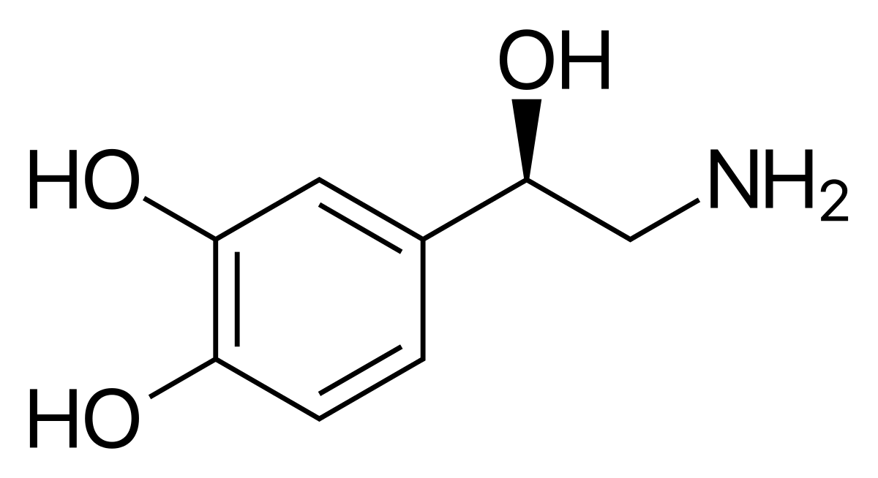
About ADHD
Lowers norepinephrine (works together with dopamine)
Frontal Cortex- Inattention, lowered executive function, disorganization
Basal Ganglia – Inattention/impulsivity
Reticular Activating System- ”relay station”
Notes:
Generally increases alertness when awake, plays large role in the sleep-wake cycle

Slide 3
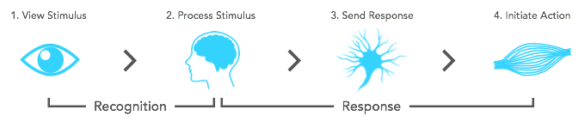
REACTION TIME

Slide 4
Hypotheses:
H₀: Reaction times of children with ADHD do not vary significantly from children without ADHD
H_{A}: Reaction times of children with ADHD do vary significantly from children without ADHD

Slide 5
Methods:
Children with ADHD-Combined Type, ADHD-Predominately Inattentive Type, and controls
Five neuropsychological tasks (Choice Discrimination Task, Child Attentional Network Task, Go/No-Go task, Stop Signal Task, and N-back task)
Multiple indicators of RT variability measured
Obtained group means for 5 tasks,
Notes:
Children with ADHD-Combined Type (n=51), ADHD-Predominantly Inattentive Type (n=53) and 47 controls completed five neuropsychological tasks (Choice Discrimination Task, Child Attentional Network Task, Go/No-Go task, Stop Signal Task, and N-back task), each allowing trial-by-trial assessment of reaction times. Multiple indicators of RT variability including RT standard deviation, coefficient of variation and ex-Gaussian tau were used.

Slide 6
Descriptive Statistics of the Dataset
Controls |  | ADHD-C |  | ADHD-I
Mean | 87.686 | Mean | 78.932 | Mean | 80.974
Standard Error | 2.3560955 | Standard Error | 4.18145836 | Standard Error | 3.25524592
Median | 88.48 | Median | 79.08 | Median | 82.83
Mode | #N/A | Mode | #N/A | Mode | #N/A
Standard Deviation | 5.2683897 | Standard Deviation | 9.35002513 | Standard Deviation | 7.27895116
Sample Variance | 27.75593 | Sample Variance | 87.42297 | Sample Variance | 52.98313
Kurtosis | -1.5745859 | Kurtosis | -1.4295969 | Kurtosis | -1.0533155
Skewness | 0.17474769 | Skewness | 0.25771671 | Skewness | 0.04477018
Range | 12.73 | Range | 22.98 | Range | 18.47
Minimum | 81.9 | Minimum | 68.4 | Minimum | 72.07
Maximum | 94.63 | Maximum | 91.38 | Maximum | 90.54
Sum | 438.43 | Sum | 394.66 | Sum | 404.87
Count | 5 | Count | 5 | Count | 5

Slide 7
T-test: ADHD-C and Controls
 | Controls | ADHD-C
Mean | 87.686 | 78.932
Variance | 27.75593 | 87.42297
Observations | 5 | 5
Pearson Correlation | 0.94619643
Hypothesized Mean Difference | 0
df | 4
t Stat | 4.17706395
P(T<=t) one-tail | 0.00697567
t Critical one-tail | 2.13184679
P(T<=t) two-tail | 0.01395134
t Critical two-tail | 2.77644511

Slide 8
T-test: ADHD-I and Controls
 | ADHD-I | Controls
Mean | 80.974 | 87.686
Variance | 52.98313 | 27.75593
Observations | 5 | 5
Pearson Correlation | 0.99281113
Hypothesized Mean Difference | 0
df | 4
t Stat | -7.0025254
P(T<=t) one-tail | 0.00109458
t Critical one-tail | 2.13184679
P(T<=t) two-tail | 0.00218917
t Critical two-tail | 2.77644511

Slide 9
T-test: ADHD-I and ADHD-C
 | ADHD-I | ADHD-C
Mean | 80.974 | 78.932
Variance | 52.98313 | 87.42297
Observations | 5 | 5
Pearson Correlation | 0.96758942
Hypothesized Mean Difference | 0
df | 4
t Stat | 1.54794991
P(T<=t) one-tail | 0.09827469
t Critical one-tail | 2.13184679
P(T<=t) two-tail | 0.19654939
t Critical two-tail | 2.77644511

Slide 10
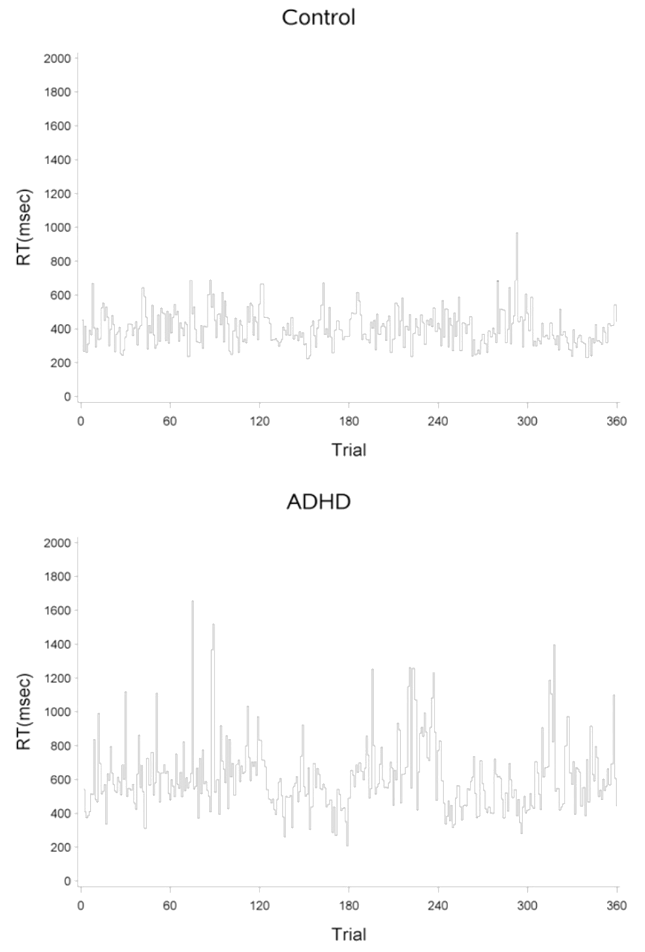

Slide 11
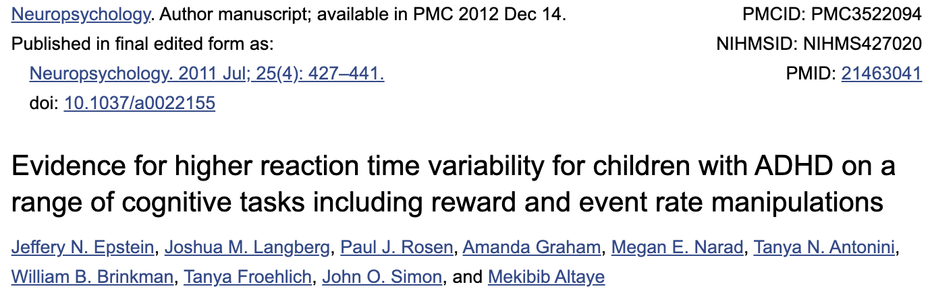
References:

